Slide 1
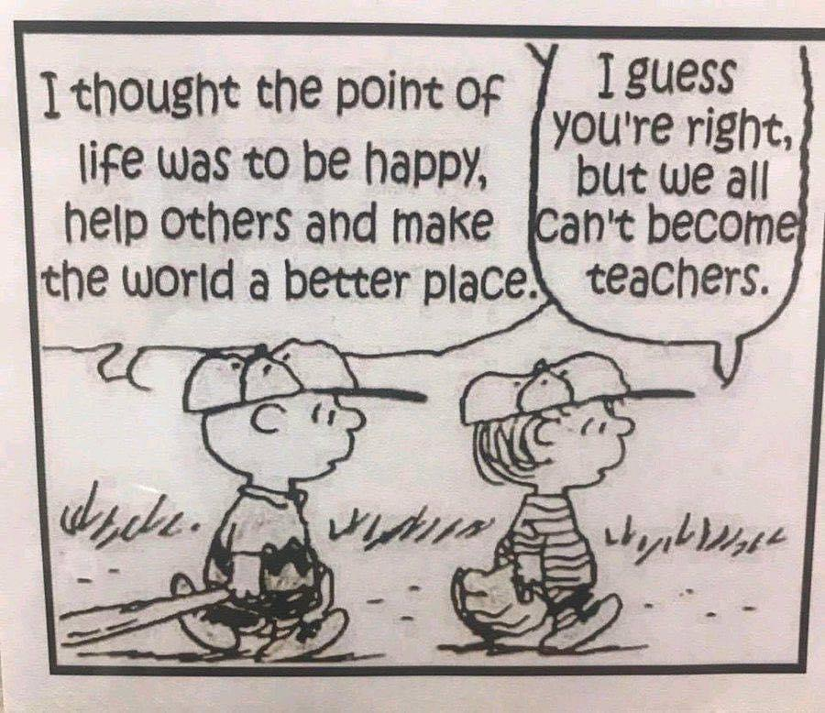
Valley ROP
Fall Inservice
2021

Slide 2
Workshop #1
Students Love Note-Taking
Reading is Hard!

Slide 3
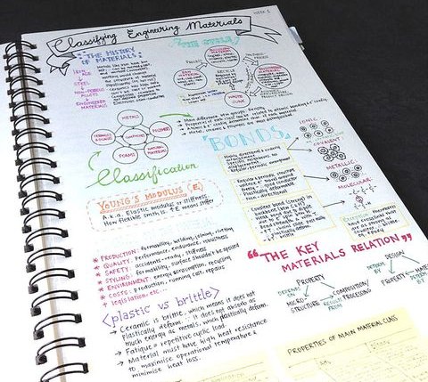
Students do not LOVE note-taking, but…
It teaches organization
Keeps everything in one place
Makes content orderly/easy to reference
Helps with accountability
Uses both sides of the brain
Increases retention

Slide 4
Students sitting at desks without a notebook:
Have amazing auditory skills
Are geniuses
Will ace the upcoming test
Perfectly understand everything
Probably don’t need to come to school
All students should have a notebook on their desks when class begins

Slide 5
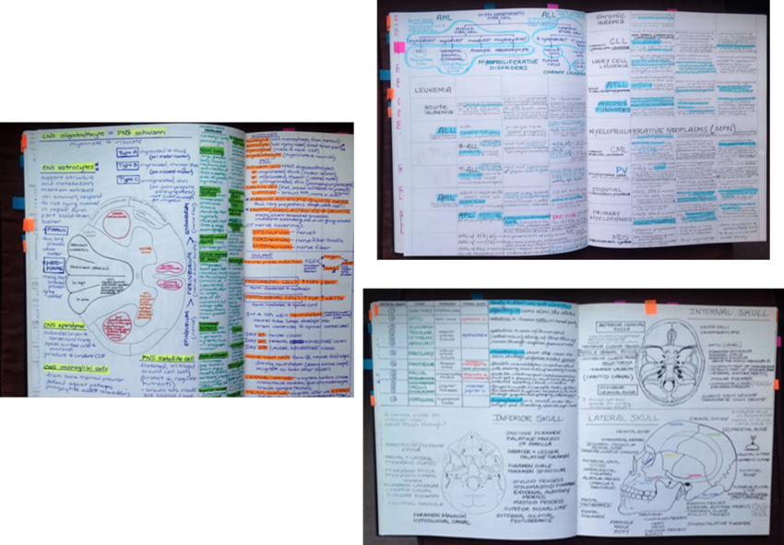
Note-Taking
takes practice!

Slide 6
Today’s activity…
Notebooks on tables
Write name on bind
Number the first 20 pages
Use at least 3 different colored pens

Slide 7
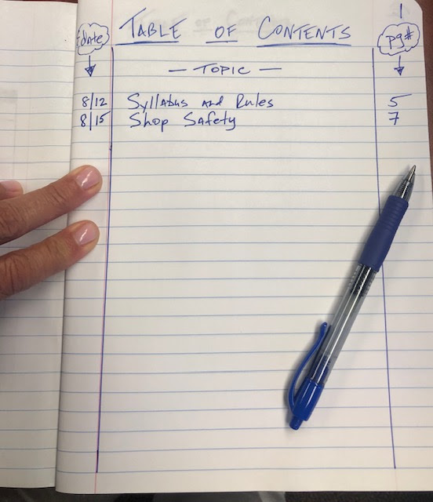
Kids need structure–
Please create
Table of Contents
on first page

Slide 8
Table of Contents Entry #1: “Forgetting Curve”

Slide 9
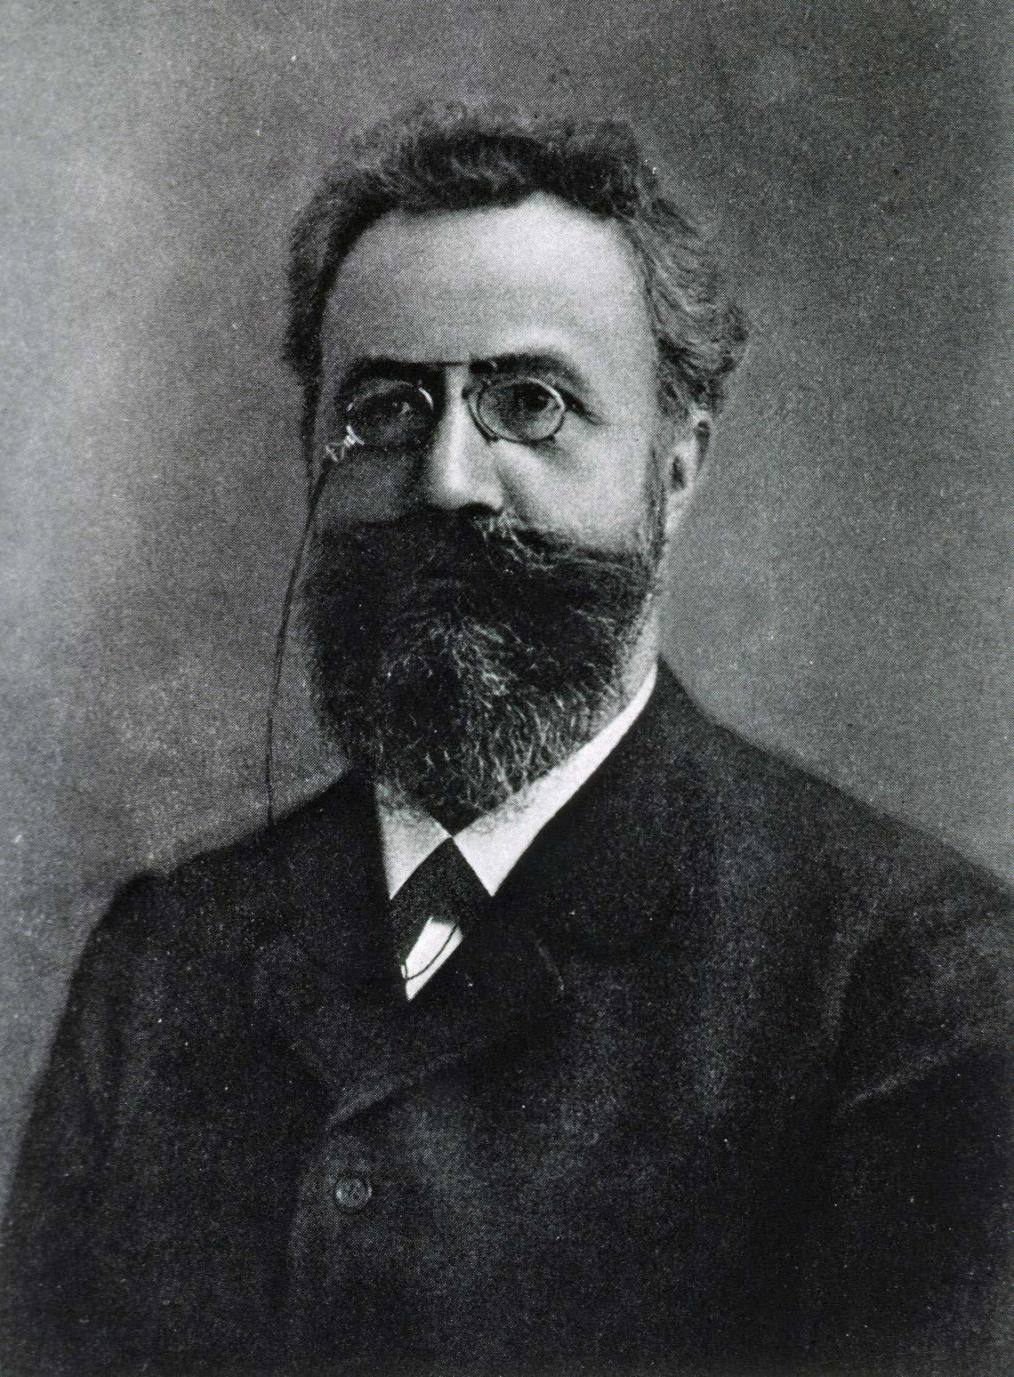
Hermann Ebbinghaus (1850-1909)
German psychologist
Experimented and researched rote learning and memory
Known for the “Forgetting Curve”

Slide 10
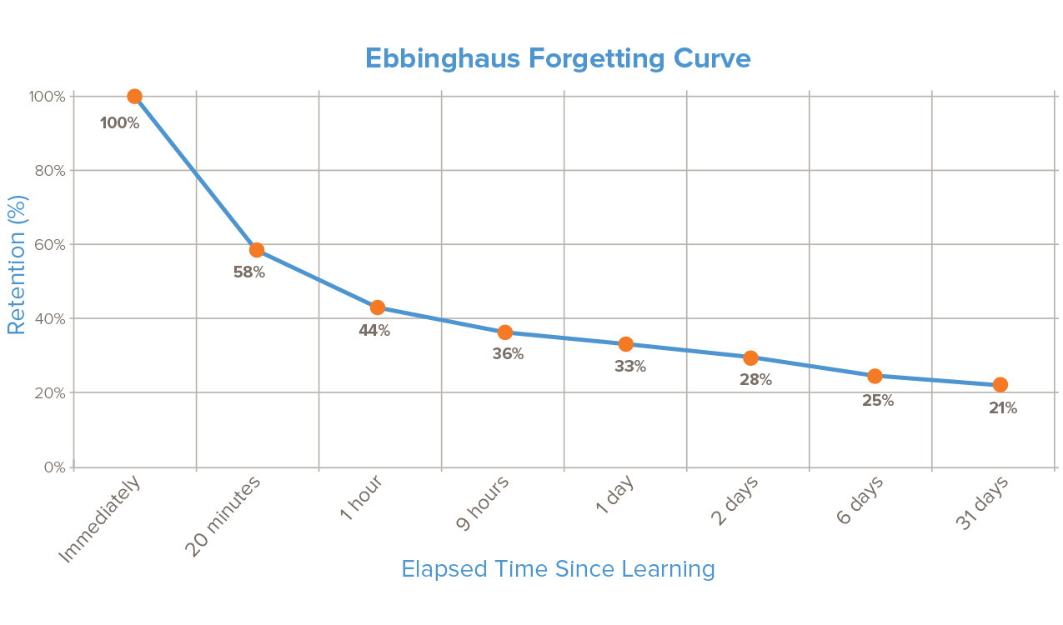
Right after lecture =
high retention
Are kids doing something w/notes 20 min later?
Kids usually in next class taking more notes
If no revisit,
80% of learning
is lost
a month later
Are students reviewing notes at night?
Is there a revisit assignment 2 days later?

Slide 11
If research states that
note-taking can be a source
to review information
in order to retain information--
what does note-taking
look like in class?

Slide 12
LEFT SIDE…
RIGHT SIDE…
Entry #2:
Left and Right Side of Notes
“Output” side or student side
Process/Review new information
Create drawings, illustrations, charts,
Analogies
Use colors!
Students are “interacting” w/ notebook
Students are re-visiting notes
“Input” side
Lecture
Power Point
Article
Textbook
Guest Speaker
Video
Table of Contents

Slide 13
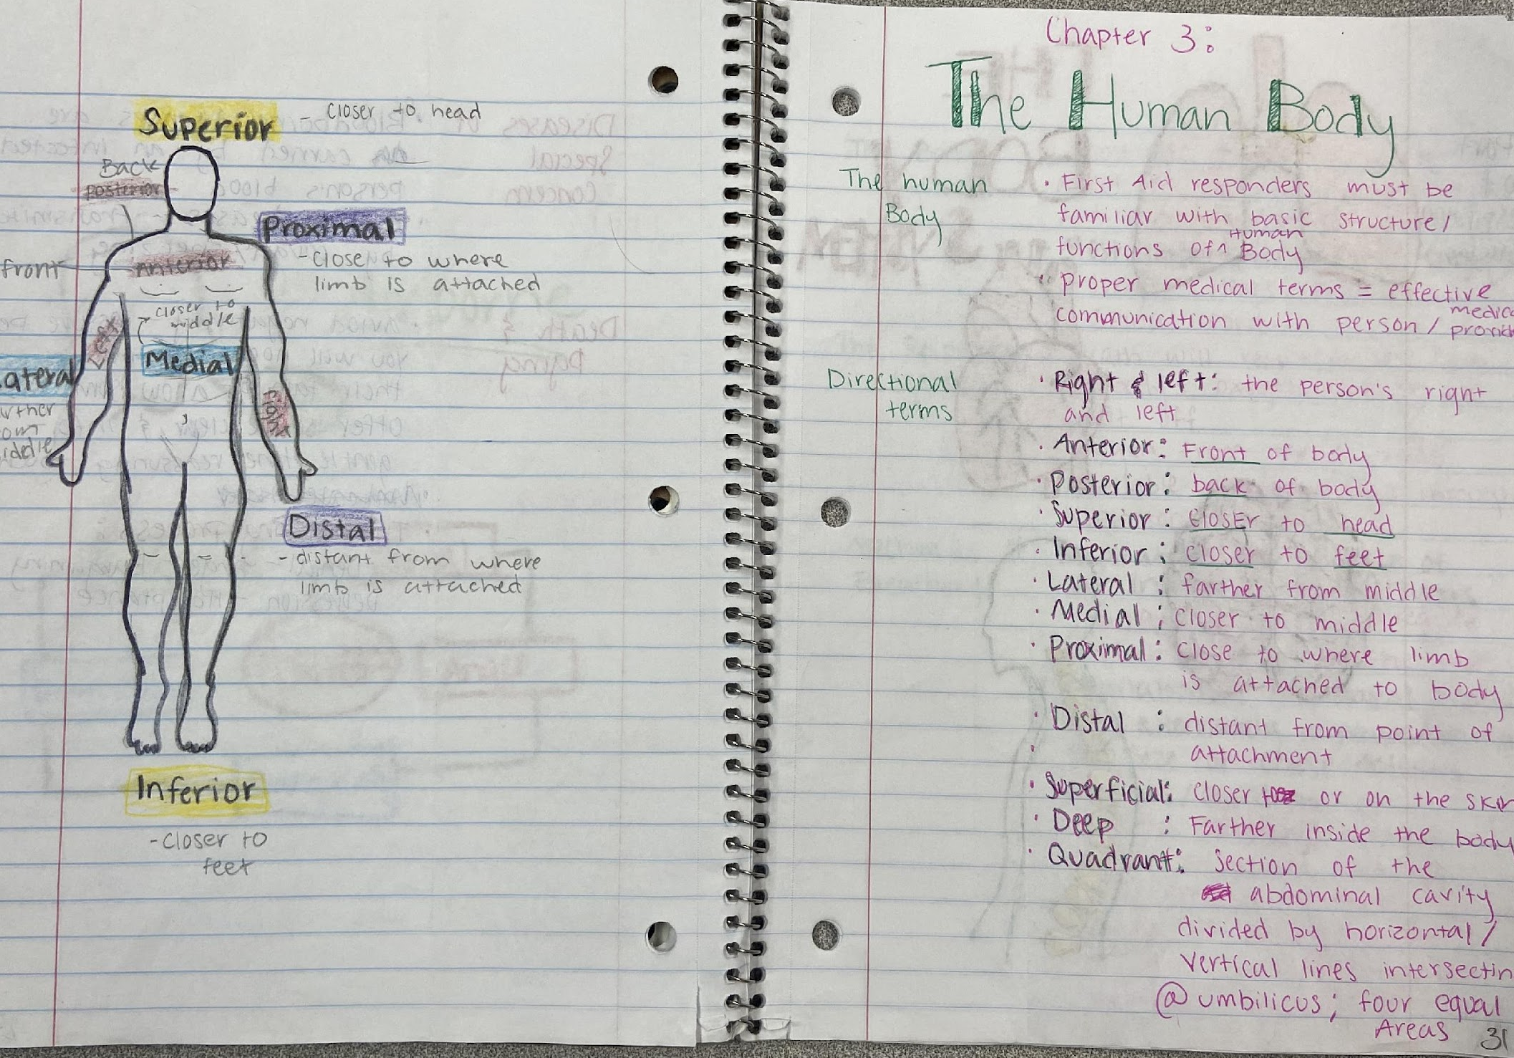
Left and Right…
Med Term

Slide 14
“The skill of taking notes in class must be practiced over and over––
it’s a skill for ALL subjects.”

Slide 15
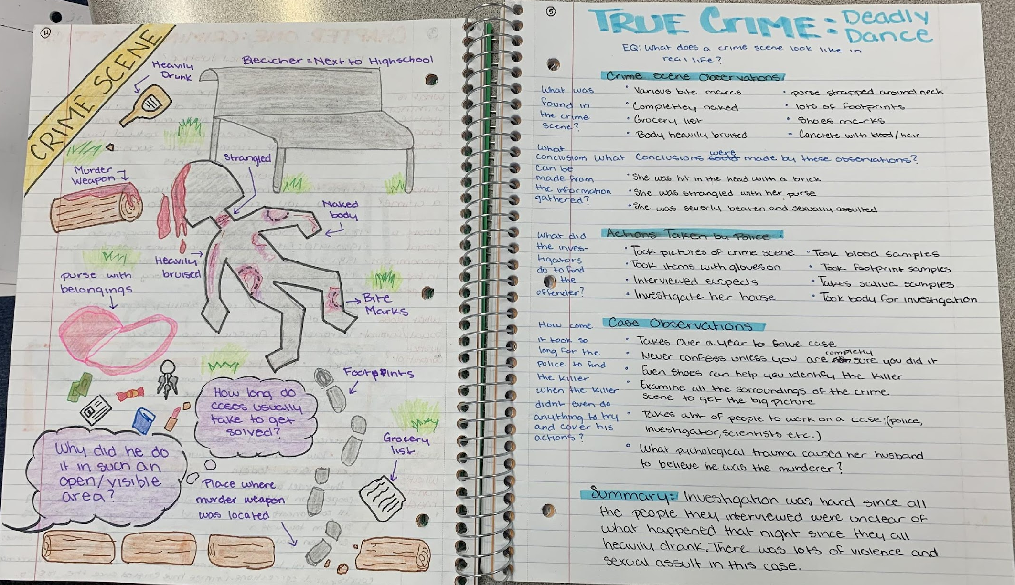
Left and Right…
CSI

Slide 16
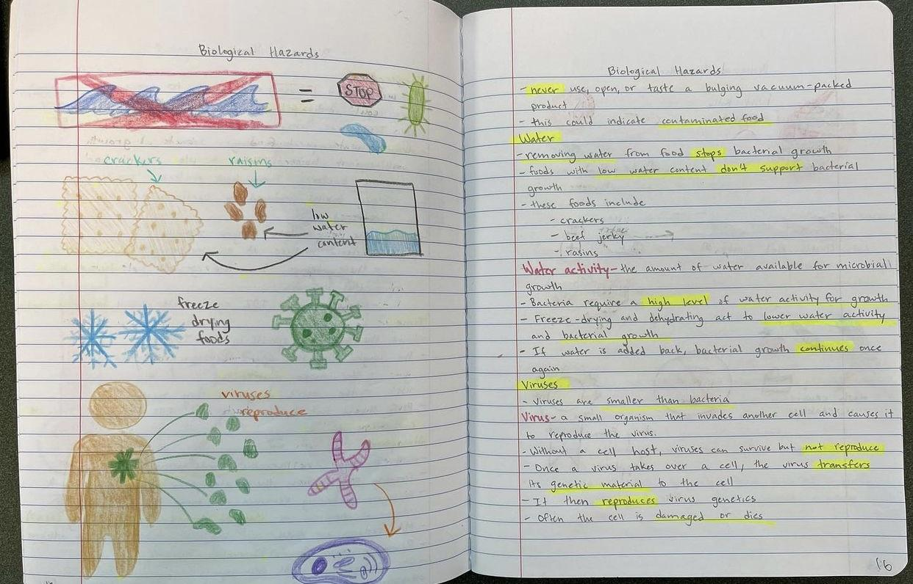
Left and Right…
Culinary

Slide 17
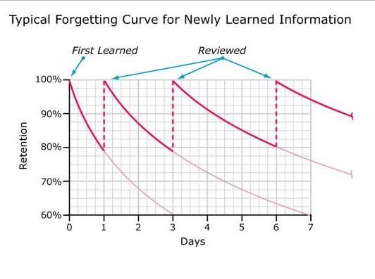
Reviewing information is key

Slide 18
Common Core Literacy Standards
Reading, Writing, Speaking and Listening, Research

Slide 19
The man who can make hard things easy— is the educator.
Reading a
novel
Reading an article
Reading a textbook
Characters, conflict, dialogue
Informative, interesting
–-Ralph Waldo Emerson
Reading is hard!
Different part
of brain

Slide 20
Entry #3 for Table of Contents
Reading is RAD
Reading Across the Disciplines

Slide 21
Why is Reading Across Disciplines important?
Enables students to navigate complex text in any content area
Helps students develop reading stamina by moving past their “roadblocks”
Revolves around METACOGNITIVE CONVERSATIONS
Textbook reading...

Slide 22
A is for…

Slide 23
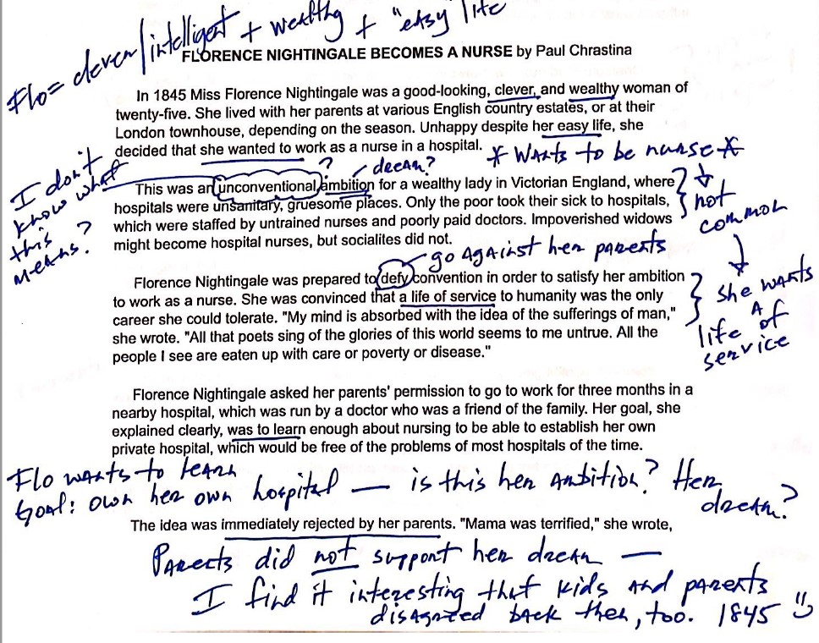
ANNOTATION
is my friend

Slide 24
Hand out

Slide 25
Reading Strategies
Talk to the Text
Golden Line
Notes:
Kirsten

Slide 26
Article in Folder…
“Adversity”

Slide 27
Talk to the Text (Reading Strategy)
Drey to Model

Slide 28
Talk to the Text
Teacher models thinking while reading text out loud
Stop – Think – React
Students write what teacher writes
Notes:
Kirsten...models teacher think aloud
Call up a victim to think aloud on doc cam
Group finishes independently

Slide 29
Golden Line (Reading Strategy)
Model
Notes:
Kirsten intro - another strategy, something you can use after reading

Slide 30
Article in Folder…
“Conclusion”

Slide 31
Golden Line
While annotating text, find a “Golden Line.” Highlight.
Where does text raise questions for you?
Where does text confirm what you already believe?
Where does text make you say aha?
Find a partner. Explain why you chose that “Golden Line.”
Notes:
Sara- give directions with each section
Kirsten will provide timing

Slide 32
The End

